Slide 1

By Ceci, Maansi & Madison

Slide 2
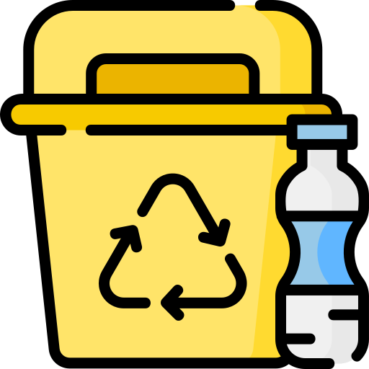
USC produced 714 tons of single-use plastics in 3 months in 2018

Slide 3

Why is this important?
USC 2020 Sustainability Goals

Slide 4


Who is our target audience?
USC Students & Faculty

Slide 5



How did we get here?
Single-use plastics Lack of education Indifference
Culture of single-use plastics in campus restaurants
Confusion of what and where to recycle
People don’t want to alter their habits and routine

Slide 6
Our Solution
A multifunctional app and integrated incentive program which
Streamlines the recycling process
Provides sustainability education
Incentivises recycling through rewards

Slide 7

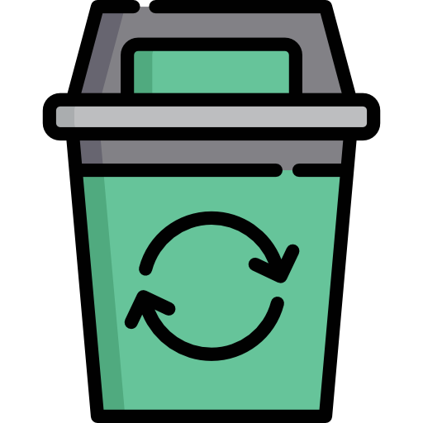

The Incentive Program
1. Scan reusable container (each container has unique barcode)
3. Once collection bin approves container, it will add certain amount of $ to purchaser’s USC ID card
2. Collection bin will open to accept container

Slide 8
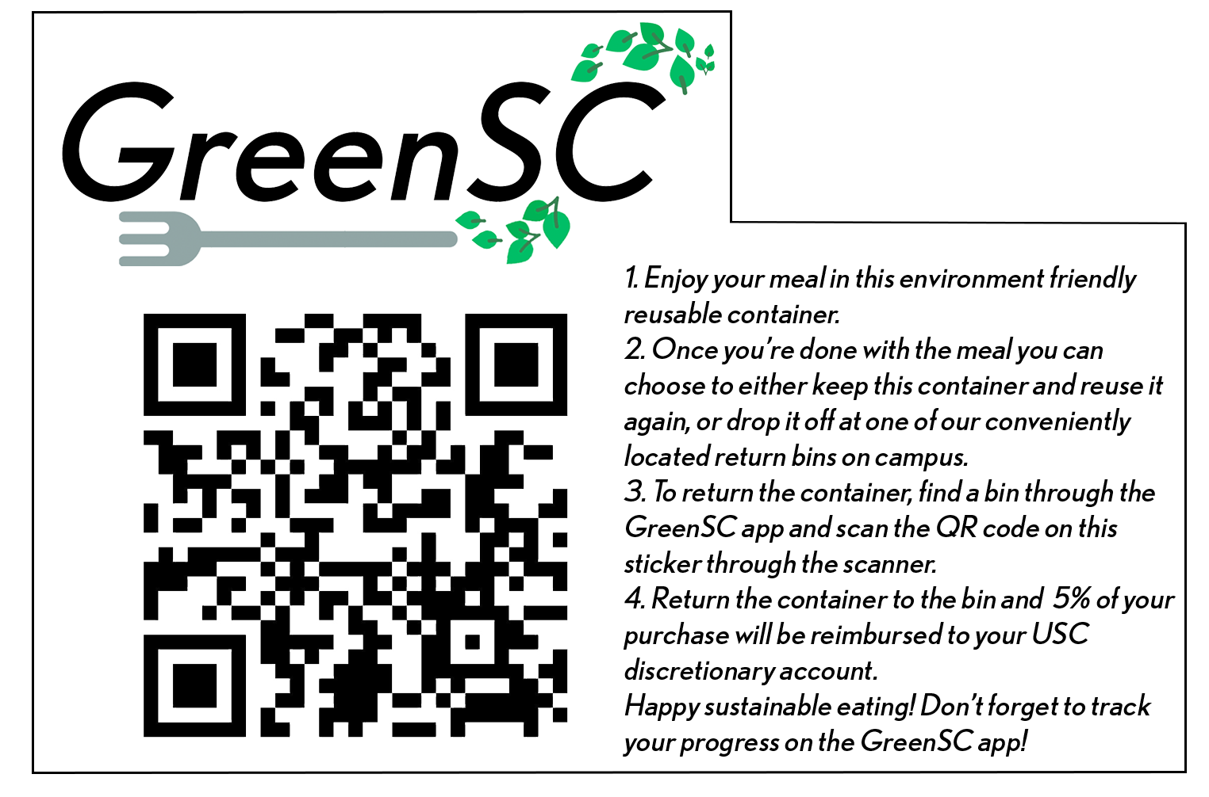


Containers, Stickers, & Bins
Example representation of a GreenSC sticker

Slide 9




Deposit container to bin
Purchase your meal
Earn dining dollars

Slide 11
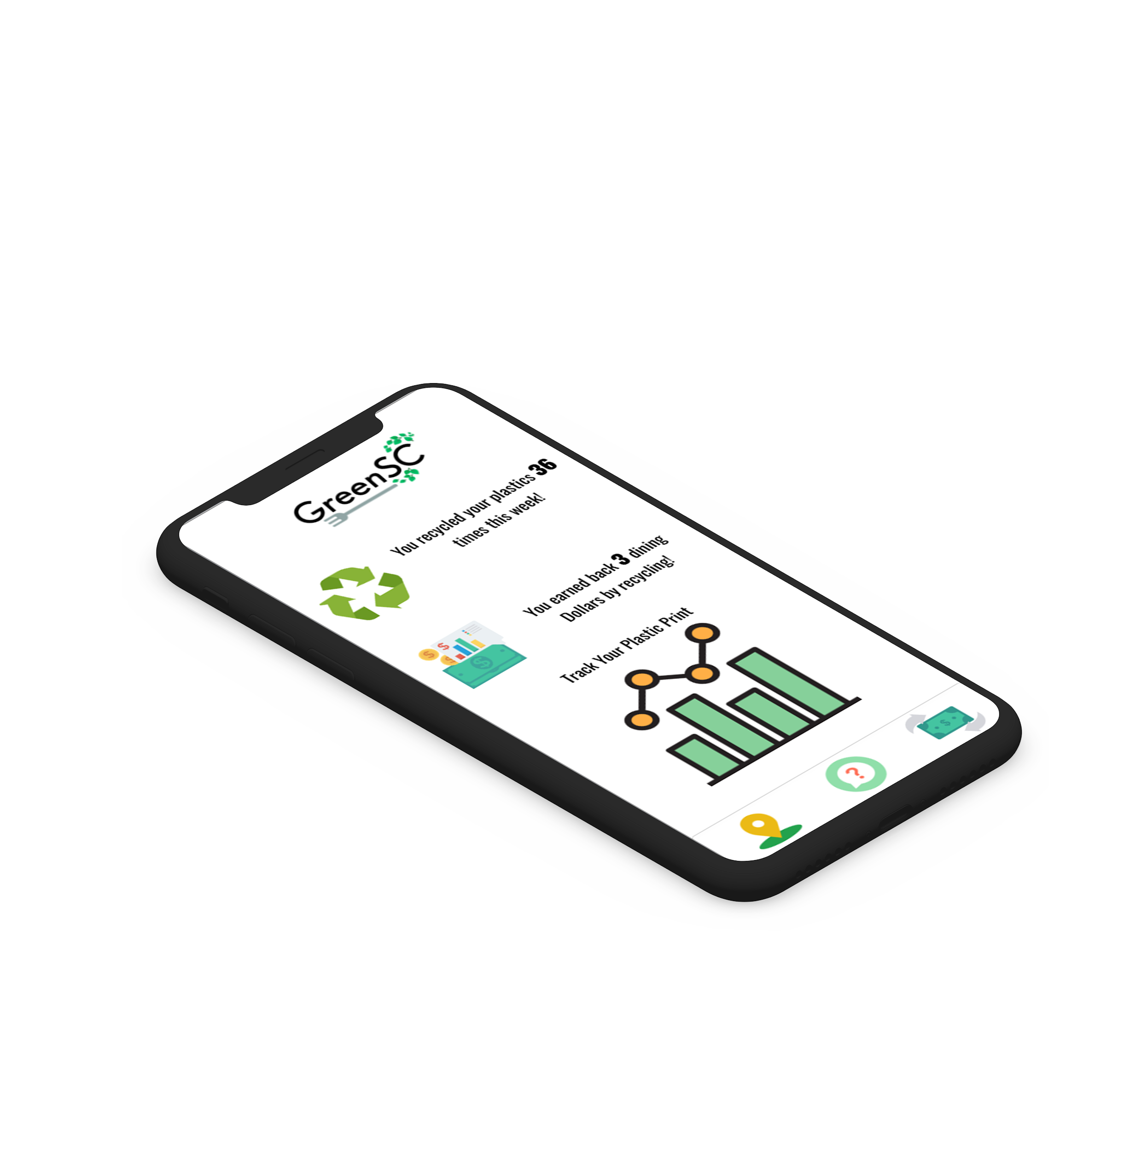

Feature #1: Tracking
Presents the dining dollars earned through the incentive program and records amount of single-use plastic the user has consumed

Slide 12
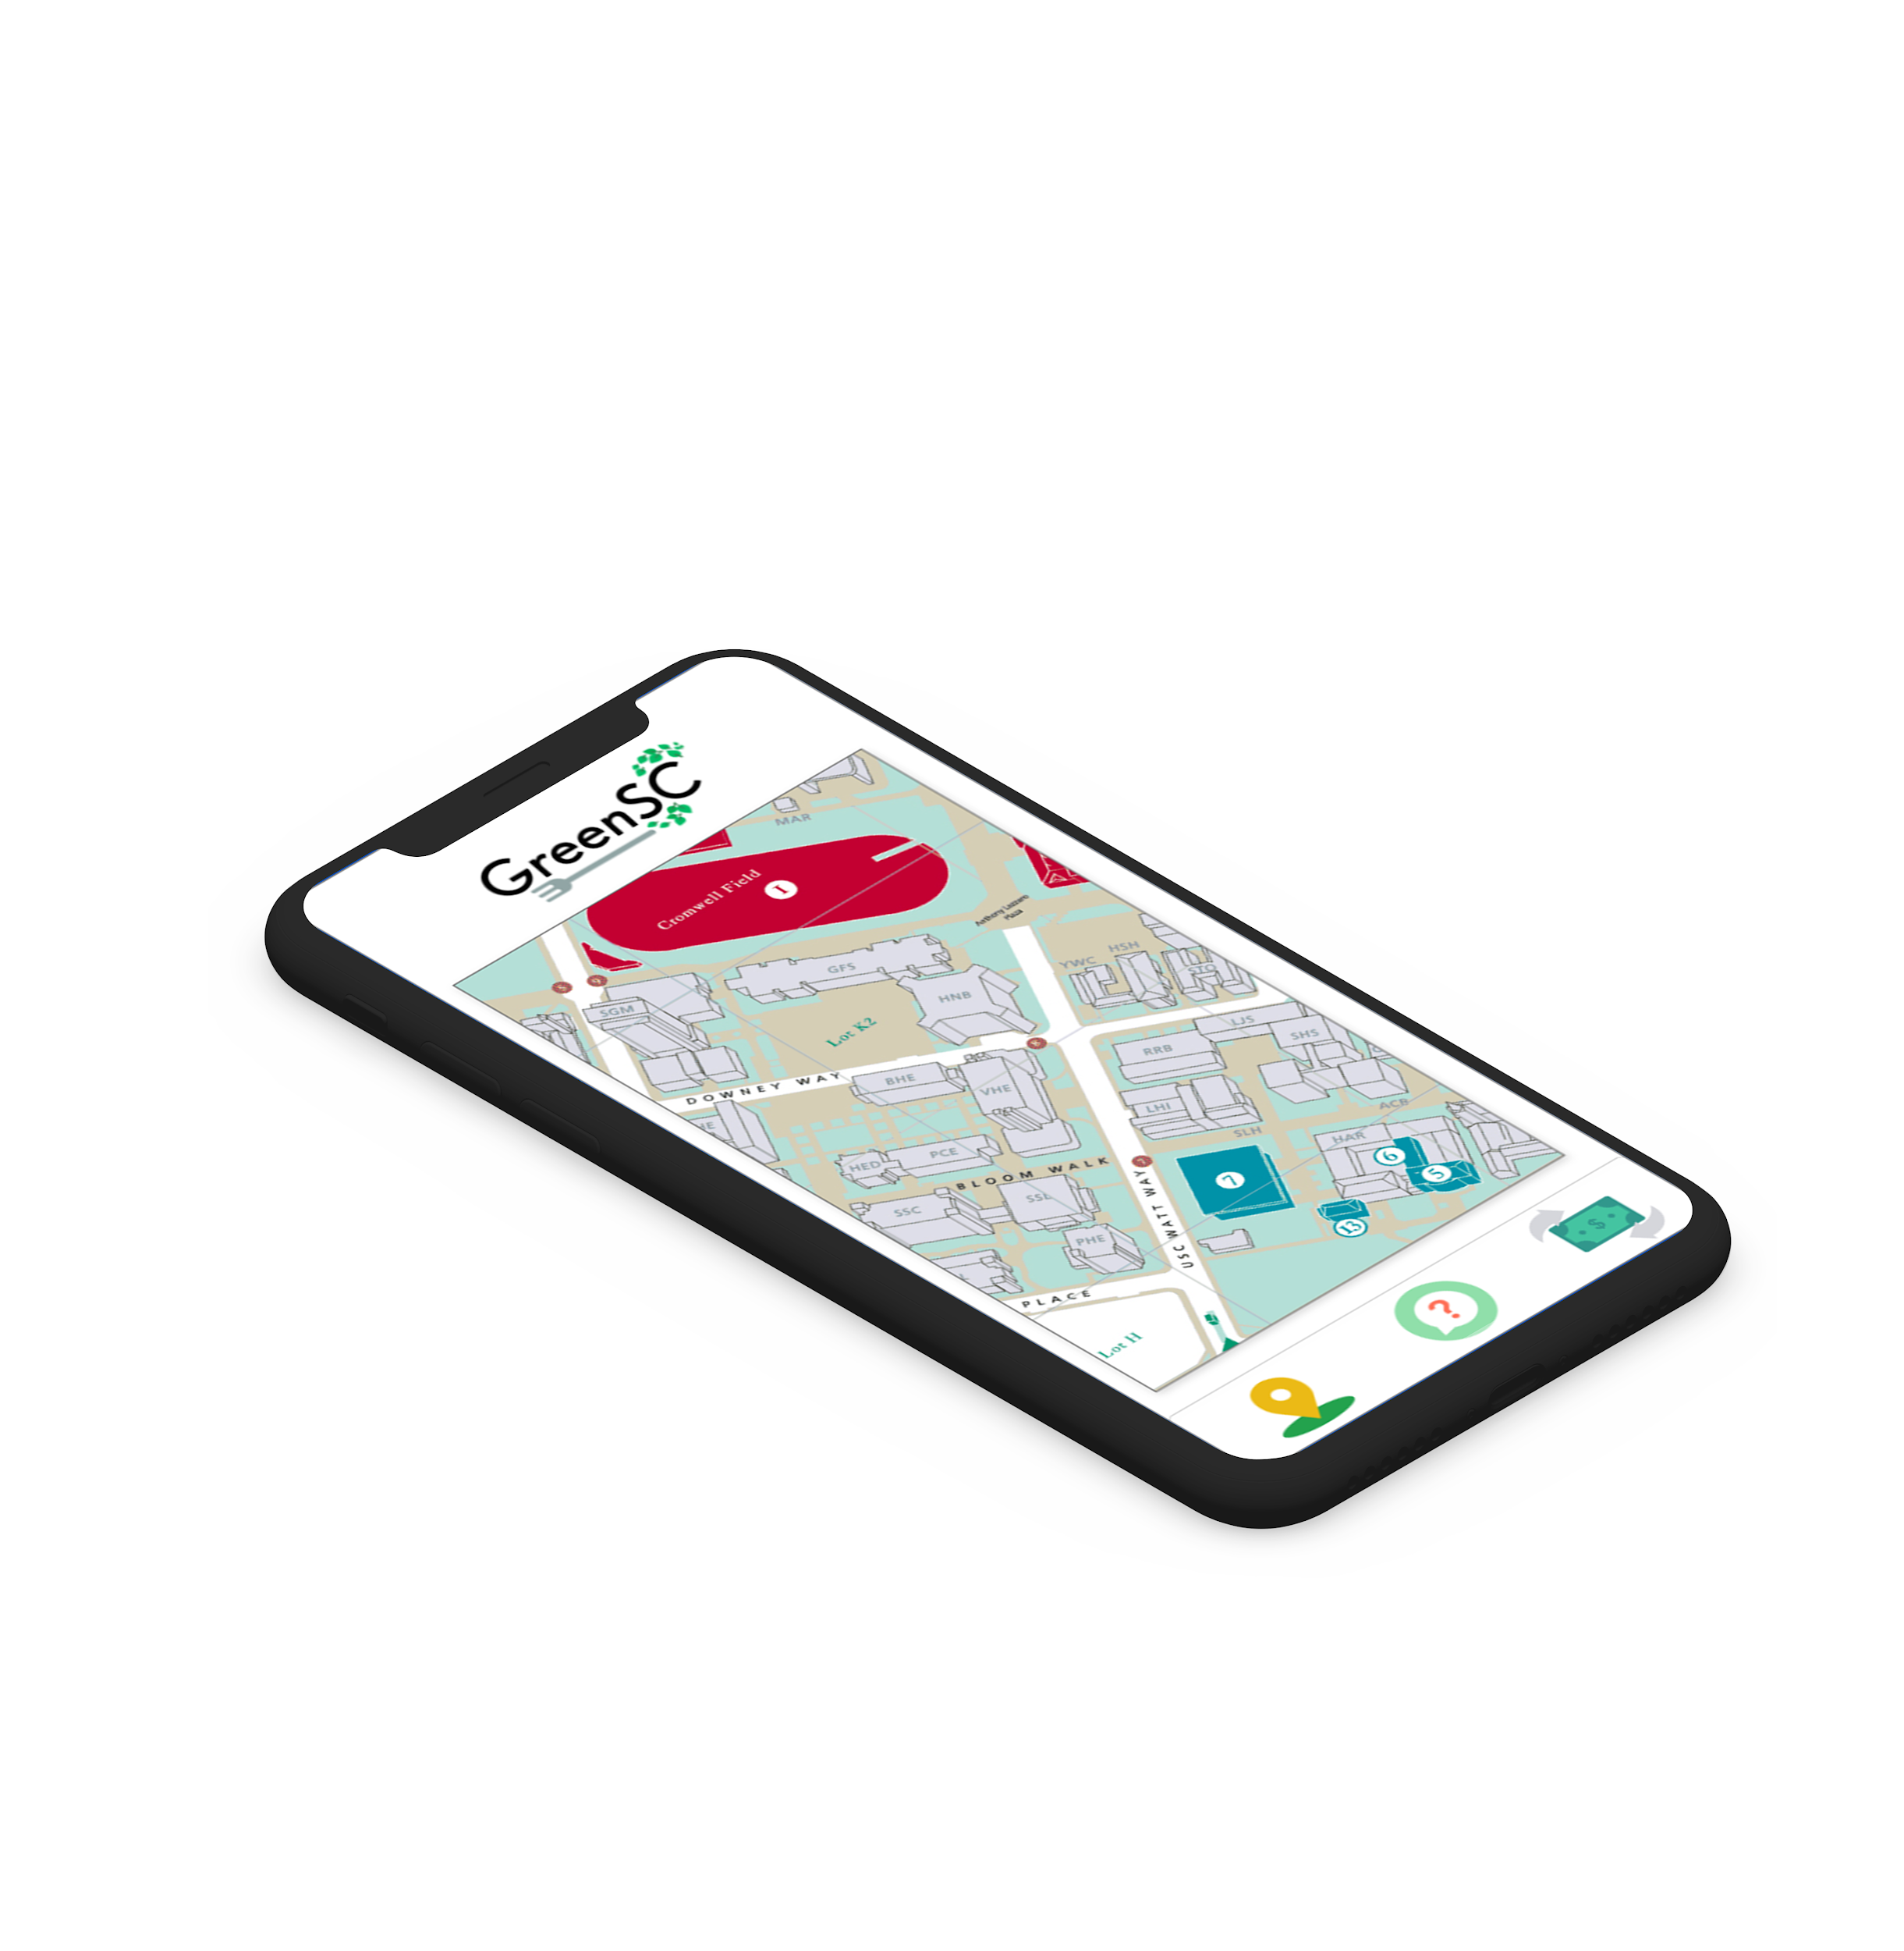

Feature #2: The Map
Highlights locations of trash cans, recycling cans, and water bottle refilling stations

Slide 13
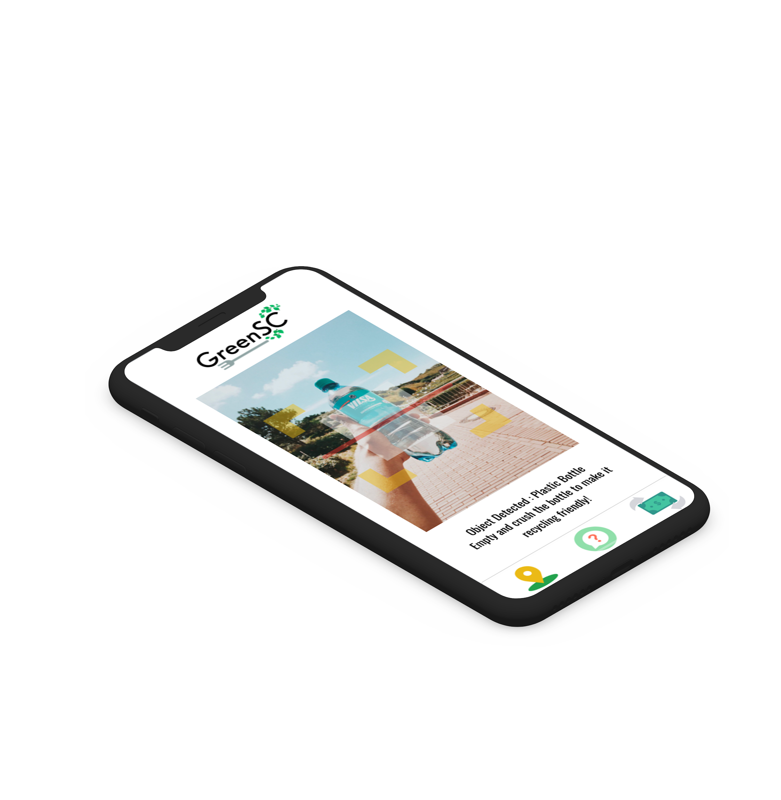

Feature #3: The Scanner
Identifies how to correctly dispose of items and provides walking directions to the nearest correct disposal

Slide 14


Campus Reforms & Funding
Scanning bins
App production
Reusable containers
Funding for the incentive program

Slide 15


Who gains what?
Sustainability Goals
Save money
More students
Notes:
USC should invest in funding for GreenSC because of the following reasons:
Helps them achieve their 2028 sustainability goals
You save money on cost of single use plastic
Good PR material for the school, USC’s emphasis on sustainability can potentially drive more students to apply, especially ones who are interested in environmental science

